Slide 1
BLOCKCHAIN 1.0 – BITCOIN AND CRYPTOCURRENCY

Slide 2
BLOCKCHAIN 1.0
BITCOIN AND CRYPTOCURRENCY : Block Hash - structure of block – syntax , structures, and validation - transaction life cycle-transaction types – Hash computation and Merkle Hash Tree -Bitcoin and importance- Creation of coins–Bitcoin P2P Network-, Bitcoin protocols - Mining strategy and rewards – PoW and PoS – Difficulty, hash rate– Wallets- Double spending – forking - Token, Coinbase - practice on MTH

Slide 3
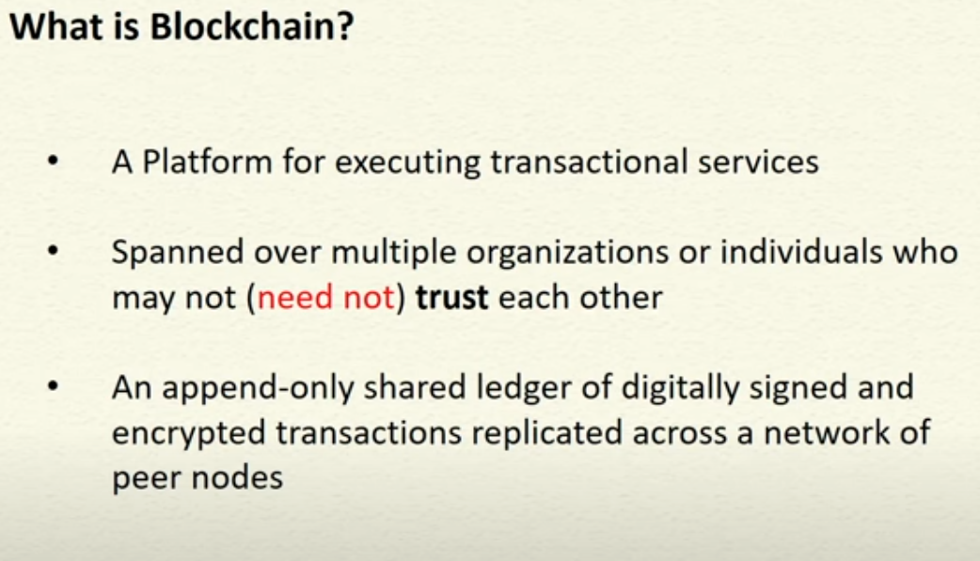

Slide 4
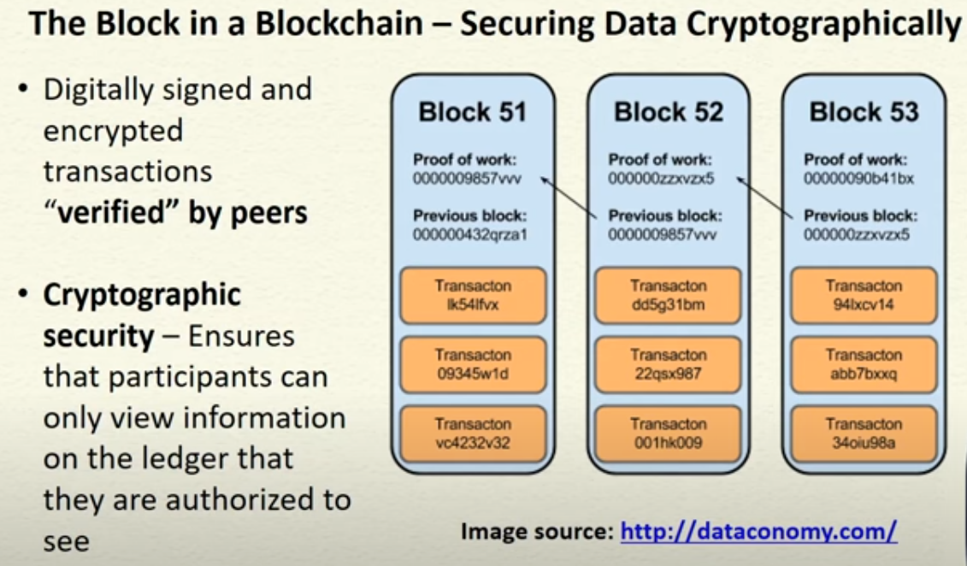

Slide 5
Structure of a Block
A block is a container data structure that contains a series of transactions
In Bitcoin A block may contain more than 500 transactions on average, the average size of a block is around 1 MB (an upper bound proposed by Satoshi Nakamoto in 2010
May grow up to 8 MB or sometime higher (several conflicting views on this!!)
Larger blocks can help in processing large number of transactions in one go.
But longer time for verification and propagation

Slide 6
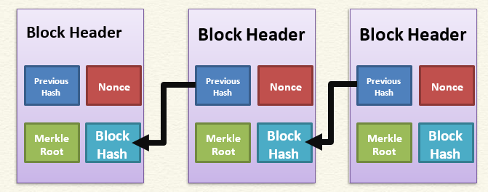
Block Generation

Slide 7
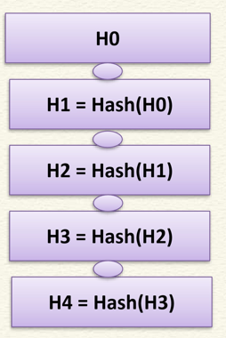
Block Header - Bitcoin
Metadata about a block –
(1) Previous block hash
(2) Mining statistics used to construct the block
(3) Merkle tree root
Previous block hash: Every block inherits from the previous block we use previous block’s hash to create the new block’s hash – make the blockchain tamper proof

Slide 8
Block Header - Bitcoin
Mining – the mechanism to generate the hash
The mechanism needs to be complicated enough, to make the blockchain tamper proof
Bitcoin Mining: Hk = Hash(Hk-1 || T || Nonce || Something more)
Find the nonce such that Hk has certain predefined complexity (number of zeros at the prefix)
The header contains mining statistics – timestamp, nonce and difficulty

Slide 9
Block Hash
A block hash (or block ID) is a unique reference for a block in the blockchain.
Every block hash is unique and is determined by the contents of the block. You can therefore use the block hash to search for a specific block in a blockchain explorer.
For example:
Most Recent Block: 00000000000000000002310849bb724f718b64cd9d56c76f485a2f1948cc15df
Block 123,456: 0000000000002917ed80650c6174aac8dfc46f5fe36480aaef682ff6cd83c3ca
Genesis Block: 000000000019d6689c085ae165831e934ff763ae46a2a6c172b3f1b60a8ce26f
Notice that all block hashes begin with a bunch of zeros. This is because for a block to be added to the blockchain, a miner must get a hash for their block below the current target value. And if the block hash is below this target value, then the block hash is naturally going to have a bunch of zeros at the start.

Slide 10
Block Generation Cost
Energy efficiency ~0.098 J/GH = ~100 J/TH
ASIC Hardware for bitcoin can perform about 750 TH/s
Hash rate approx. 120M TH/s!! Many actually go waste ☹
Network consumes about 80 TW-hours of electricity annually. Figures vary between sources and are some form of estimates
Average household in Germany of four people consumes approx. 4,000 KW-hours of electricity per year.
Can power about 20,000 households
Concept of Pooling is used (https://btc.com/)
What ensures tamperproof operation in terms of honest nodes?

Slide 11
Blockchain Replicas
Every peer in a Blockchain network maintains a local copy of the Blockchain.
Size is just about 351 GB
As a new user joins the network, she can get the whole copy
Requirements
All the replicas need to be updated with the last mined block
All the replicas need to be consistent– the copies of the Blockchain at different peers need to be exactly similar

Slide 12
Validation:
Initial Block Download (IBD):
When a node joins the network, it downloads the entire blockchain and validates each block against the network rules.
Regular Block Validation:
Nodes validate each new block received, checking: The block's structure and format.
The validity of transactions within the block.
Whether the block's hash meets the current difficulty target.
The validity of the previous block's hash.

Slide 13
Transactions in a Block
Transactions are organized as a Merkle Tree. The Merkle Root is used to construct the block hash
If you change a transaction, you need to change all the subsequent block hashes
The difficulty of the mining algorithm determines the toughness of tampering with a block in a blockchain

Slide 14
The transaction life cycle
1. User/sender sends a transaction using wallet software or some other interface.
2. The wallet software signs the transaction using the sender's private key.
3. The transaction is broadcasted to the Bitcoin network using a flooding algorithm.
4. Mining nodes (miners) who are listening for the transactions verify and include this transaction in the next block to be mined. Just before the transaction are placed in the block they are placed in a special memory buffer called transaction pool.
5. Mining starts, which is a process by which the blockchain is secured and new coins are generated as a reward for the miners who spend appropriate computational resources.

Slide 15
The transaction life cycle
6. Once a miner solves the PoW problem it broadcasts the newly mined block to the network.
7. The nodes verify the block and propagate the block further, and confirmations start to generate.
8. Finally, the confirmations start to appear in the receiver's wallet and after approximately six confirmations, the transaction is considered finalized and confirmed. However, six is just a recommended number; the transaction can be considered final even after the first confirmation. The key idea behind waiting for six confirmations is that the probability of double spending is virtually eliminated after six confirmations

Slide 16
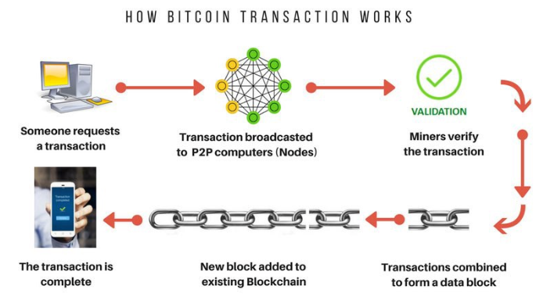
Transaction life cycle

Slide 17
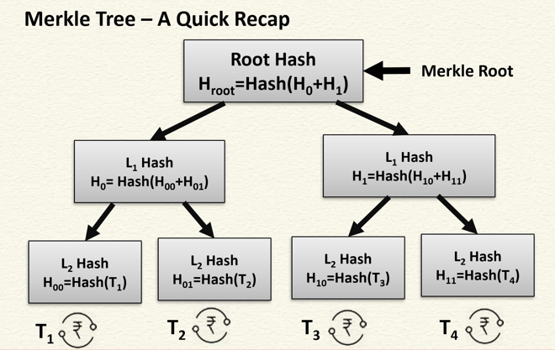
Merkle Tree

Slide 18
Merkle Tree
A Merkle tree in Bitcoin is a cryptographic data structure that efficiently summarizes all transactions within a block.
It acts like a digital fingerprint for the block's transactions, allowing for quick verification of data integrity.
This summary, called the Merkle root, is stored in the block header, enabling light clients to verify transactions without needing to download the entire blockchain.

Slide 19
Working of Merkle Tree
1. Hashing:
Each transaction in a block is first hashed using a cryptographic hash function (like SHA-256 in Bitcoin).
2. Pairing and Hashing:
These transaction hashes are then paired up, and each pair is hashed again. This process continues, with the resulting hashes being paired and hashed until only one hash remains – the Merkle root.
3. Merkle Root:
The Merkle root represents a concise summary of all transactions in the block.
4. Verification:
Light clients can download only the Merkle root and a few transaction hashes (a Merkle proof) to verify if a specific transaction is included in a block, without needing to download the entire block.

Slide 20
Transaction fee
Transaction fees are charged by the miners. The fee charged is dependent upon the size and weight of the transaction.
Transaction fees are calculated by subtracting the sum of the inputs and the sum of the outputs.
A formula can be used: fee = sum(inputs) - sum(outputs).
The fees are used as an incentive for miners to encourage them to include a user transaction in the block the miners are creating.
All transactions end up in the memory pool, from where miners pick up transactions based on their priority to include them in the proposed block.
From a transaction fee point of view, a transaction with a higher fee will be picked up sooner by the miners.
There are different rules based on which fee is calculated for various types of actions, such as sending transactions, inclusion in blocks, and relaying by nodes.

Slide 21
Transaction fee
Fees are not fixed by the Bitcoin protocol and are not mandatory; even a transaction with no fee will be processed in due course but may take a very long time.
This is however no longer practical due to the high volume of transactions and competing investors on the Bitcoin network, therefore it is advisable to provide a fee always.
The time for transaction confirmation usually ranges from 10 minutes to over 12 hours in some cases.
Transaction time is dependent on transaction fees and network activity.
If the network is very busy then transactions will take longer to process and if you pay a higher fee then your transaction is more likely to be picked by miners first due to additional incentive of the higher fee.
Transaction pools : memory pools, these pools are basically created in local memory (computer RAM) by nodes in order to maintain a temporary list of transactions that are not yet confirmed in a block. Transactions are included in a block after passing verification and based on their priority.

Slide 22
The transaction structure
Field | Size | Description
Version Number | 4 bytes | Used to specify rules to be used by the miners and nodes for transaction processing.
input counter | 1 bytes-9bytes | The number of inputs included in the transaction.
list of inputs | variable | Each input is composed of several fields, including Previous transaction hash, Previous Txout-index, Txin-script length, Txinscript,and optional sequence number. The first transaction in a block is also called a coinbase transaction. It specifies one or more transaction inputs.
out-counter | 1 bytes-9bytes | A positive integer representing the number of outputs.
list of outputs | variable | Outputs included in the transaction.
lock_time | 4 bytes | This defines the earliest time when a transaction becomes valid. It is either a Unix timestamp or a block number.

Slide 23
The transaction structure
A transaction at a high level contains metadata, inputs, and outputs.
Transactions are combined to create a Block
Metadata: contains the size of the transaction, the number of inputs and outputs, the hash of the transaction, and a lock_time field. Every transaction has a prefix specifying the version number.
Inputs: Generally, each input spends a previous output. Each output is considered an Unspent Transaction Output (UTXO) until an input consumes it.
Outputs: Outputs have only two fields, and they contain instructions for the sending of bitcoins. The first field contains the amount of Satoshis, whereas the second field is a locking script that contains the conditions that need to be met in order for the output to be spent. More information on transaction spending using locking and unlocking scripts and producing outputs is discussed later in this section.
Verification: Verification is performed using bitcoin's scripting language.

Slide 24
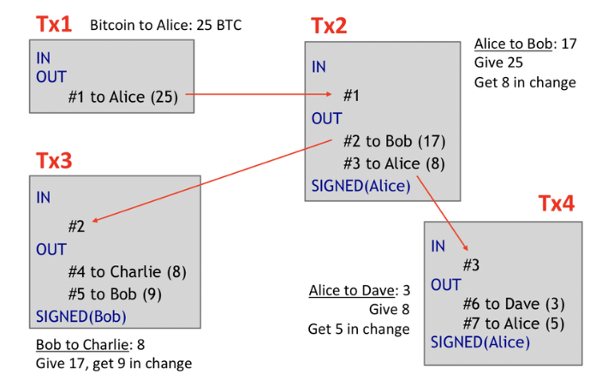
Unspent Transaction Output (UTXO)

Slide 25
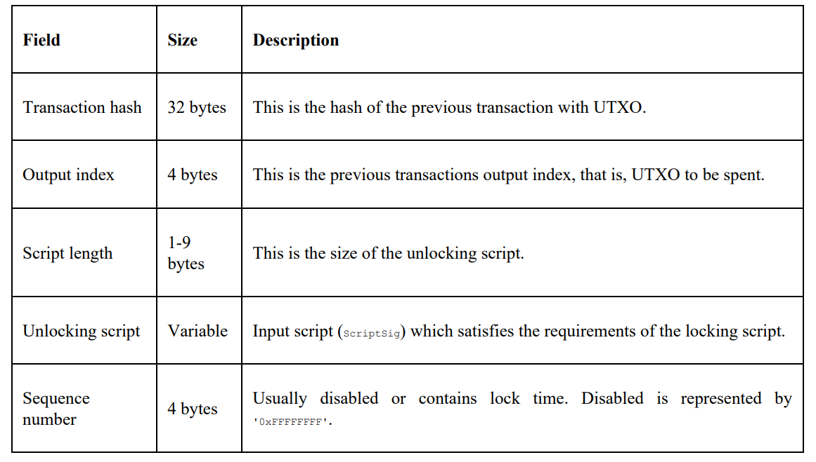
Inputs

Slide 26
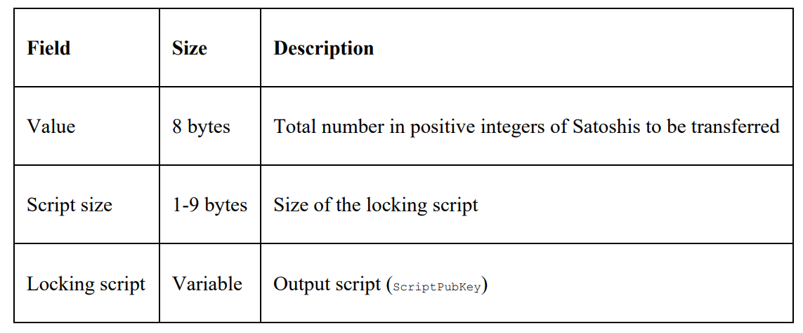
Outputs

Slide 27
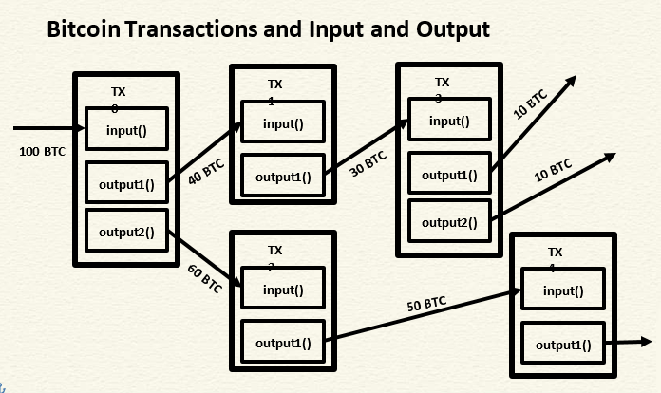

Slide 28
Verification
Verification is performed using Bitcoin's scripting language.
The script language : Bitcoin uses a simple stack-based language called script
describe how bitcoins can be spent and transferred.
This scripting language is based on a Forth programming language like syntax and uses a reverse polish notation in which every operand is followed by its operators.
It is evaluated from the left to the right using a Last In, First Out (LIFO) stack.
Not Turing Complete (no loops)
Scripts use various opcodes or instructions to define their operation.

Slide 29
Bitcoin Script Instructions
Total 256 opcodes (15 disabled, 75 reserved)
Arithmetic operations
if-then conditions
Logical operators
Data handling (like OP_DUP)
Cryptographic operations
Hash functions
Signature verification
Multi-signature verification

Slide 30
Bitcoin Scripts
Bitcoin scripts are small programs written in a Forth-like, stack-based language that dictate how Bitcoin transactions are validated and how funds can be spent.
They are used to define the conditions under which an output (an unspent transaction) can be used as input in a new transaction.
These scripts are fundamental to Bitcoin's functionality, enabling features like multi-signature transactions and more complex transaction logic.

Slide 31
Stack-based language:
Bitcoin Script is a stack-based language, meaning it operates by pushing data onto and popping data off a stack.
Limited and non-Turing complete:
It's intentionally designed to be limited and not Turing-complete, meaning it cannot perform complex computations or loops.
This limitation is crucial for security, preventing infinite loops and ensuring predictable transaction processing.
Locking and unlocking scripts:
Each transaction output (UTXO) has a locking script (ScriptPubKey) that specifies the conditions for spending those funds.
To spend those funds, an unlocking script (ScriptSig or Witness) must be provided, which satisfies the conditions set by the locking script.

Slide 32
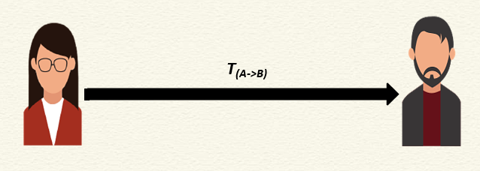
Bitcoin Scripts – A Simple Example
How Bob will verify that the transaction is actually originated from Alice?

Slide 33
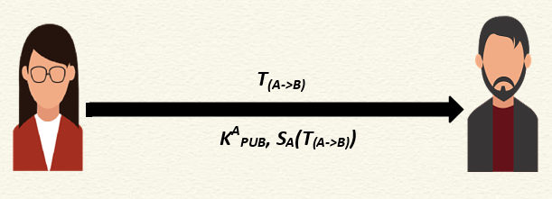
Bitcoin Scripts – A Simple Example
Send the public key of Alice along with the signature -> Bob can verify this

Slide 34
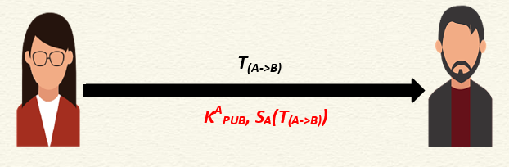
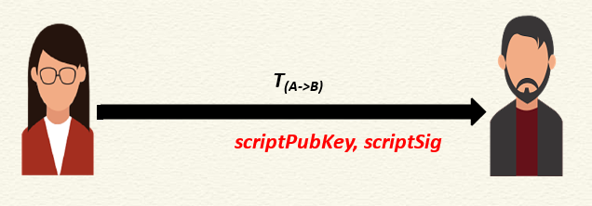
Bitcoin Scripts – A Simple Example
Bitcoin indeed transfers scripts instead of the signature and the public key
Bob can spend the bitcoin only if both the scripts return TRUE after execution

Slide 35
Bitcoin Scripts
Simple, compact, stack-based and processed left to right
FORTH like language
Not Turing Complete (no loops)
Halting problem is not there

Slide 36
Bitcoin Scripts
With every transaction Bob must provide
A public key that, when hashed, yields the address of Bob embedded in the script
A signature to provide ownership of the private key corresponding to the public key of Bob

Slide 37
Verification
A transaction script is evaluated by combining ScriptSig and ScriptPubKey.
ScriptSig is the unlocking script, whereas ScriptPubKey is the locking script.
how a transaction to be spent is evaluated?
1. it is unlocked and then it is spent
2. ScriptSig is provided by the user who wishes to unlock the transaction
3. ScriptPubkey is part of the transaction output and specifies the conditions that need to be fulfilled in order to spend the output
4. In other words, outputs are locked by ScriptPubKey that contains the conditions, when met will unlock the output, and coins can then be redeemed

Slide 38
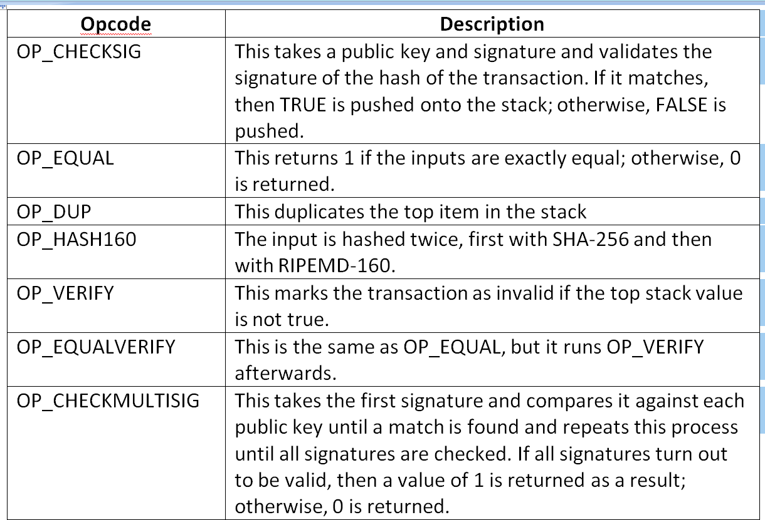
Commonly used opcodes

Slide 39
Verification
There are various scripts available in Bitcoin to handle the value transfer from the source to the destination.
These scripts range from very simple to quite complex depending upon the requirements of the transaction.
Standard transactions are evaluated using IsStandard() and IsStandardTx() tests and only standard transactions that pass the test are generally allowed to be mined or broadcasted on the Bitcoin network.
However, nonstandard transactions are valid and allowed on the network.

Slide 40
Types of transactions
Pay to Public Key Hash (P2PKH): P2PKH is the most commonly used transaction type and is used to send transactions to the bitcoin addresses. The format of the transaction is shown as follows:
The ScriptPubKey and ScriptSig parameters are concatenated together and executed.
Pay to Script Hash (P2SH): P2SH is used in order to send transactions to a script hash (that is, the addresses starting with 3) and was standardized in Bitcoin Improvement Proposal (BIP16). In addition to passing the script, the redeem script is also evaluated and must be valid.

Slide 41
Types of transactions
MultiSig (Pay to MultiSig): M-of-N MultiSig transaction script is a complex type of script where it is possible to construct a script that required multiple signatures to be valid in order to redeem a transaction. Various complex transactions such as escrow and deposits can be built using this script. The template is shown here:
multisig is usually part of the P2SH redeem script, mentioned in the previous bullet point
Pay to Pubkey: This script is a very simple script that is commonly used in coinbase transactions. It is now obsolete and was used in an old version of bitcoin. The public key is stored within the script in this case, and the unlocking script is required to sign the transaction with the private key.
<pubKey> OP_CHECKSIG

Slide 42
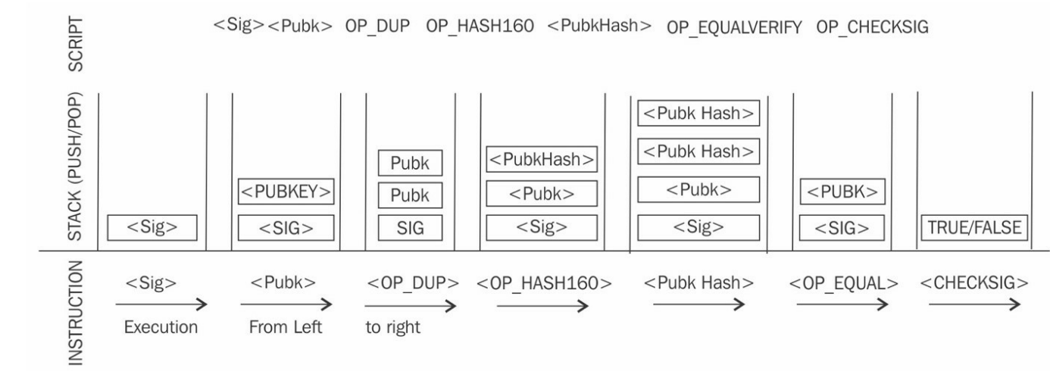
Types of transactions
Null data/OP_RETURN: This script is used to store arbitrary data on the blockchain for a fee. The limit of the message is 40 bytes. The output of this script is unredeemable because OP_RETURN will fail the validation in any case. ScriptSig is not required.
OP_RETURN <data>
A P2PKH script execution is shown in the following diagram:

